Slide 1

Chapter 4
Emotions and Communication

Slide 2

Understanding Emotions
Emotional Intelligence
Theories of Emotion Perception
Emotional Expressions
Processing Emotions
Identifying emotions

Slide 3

Emotions
We Express Emotions Verbally and Nonverbally

Slide 4
Emotional Intelligence is…
... the ability to
recognize which
feelings are
appropriate in which
situations, and the
skill to communicate
those feelings
effectively.
Knowing Your Feelings
Managing Your Emotions
Handling Setbacks
Channeling Feelings to Achieve Goals
Having Empathy
Learning from Feelings
Having Realistic Optimism

Slide 5
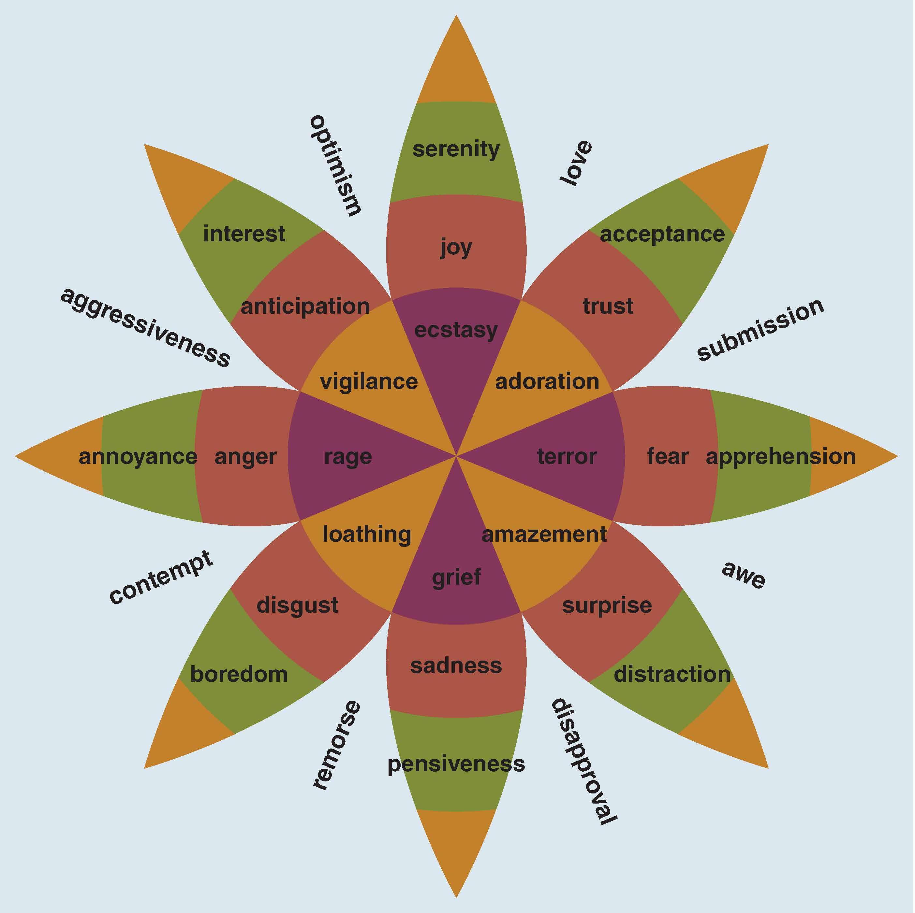
Emotional Range
What Is Your Emotional Range?

Slide 6
Emotions are…
Our experience and interpretation of internal sensations as those are shaped by physiology, perceptions, language, and social experiences.

Slide 7
Understanding Emotions
Emotions
Physiological
Perceptual
Social

Slide 8
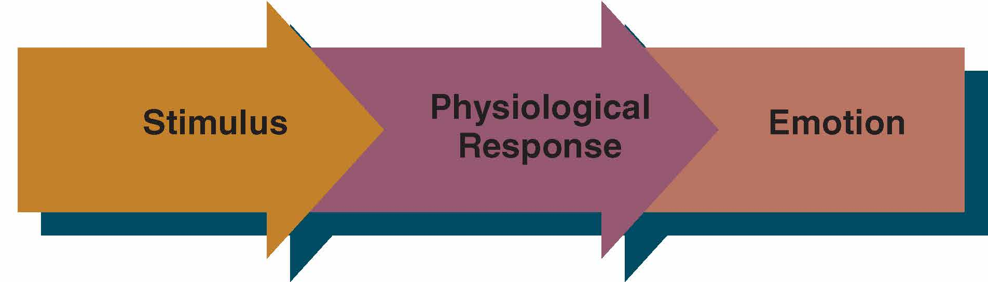
Physiological Influences on Emotions
The Organismic View of Emotions

Slide 9
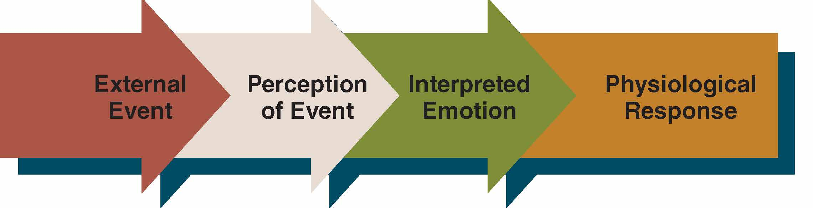
Perceptual Influences on Emotions
Perceptual View
Appraisal Theory

Slide 10
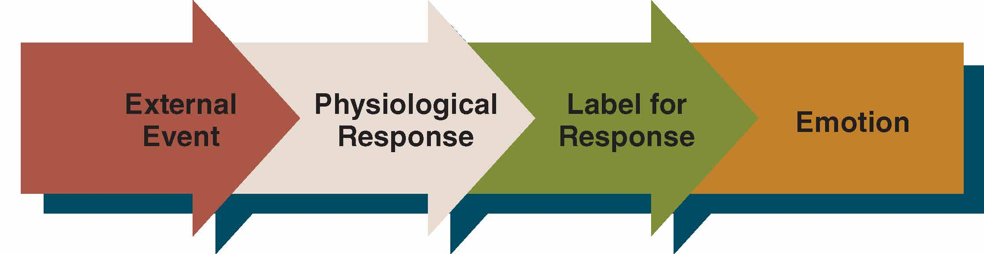
Cognitive Labeling View of Emotions

Slide 11
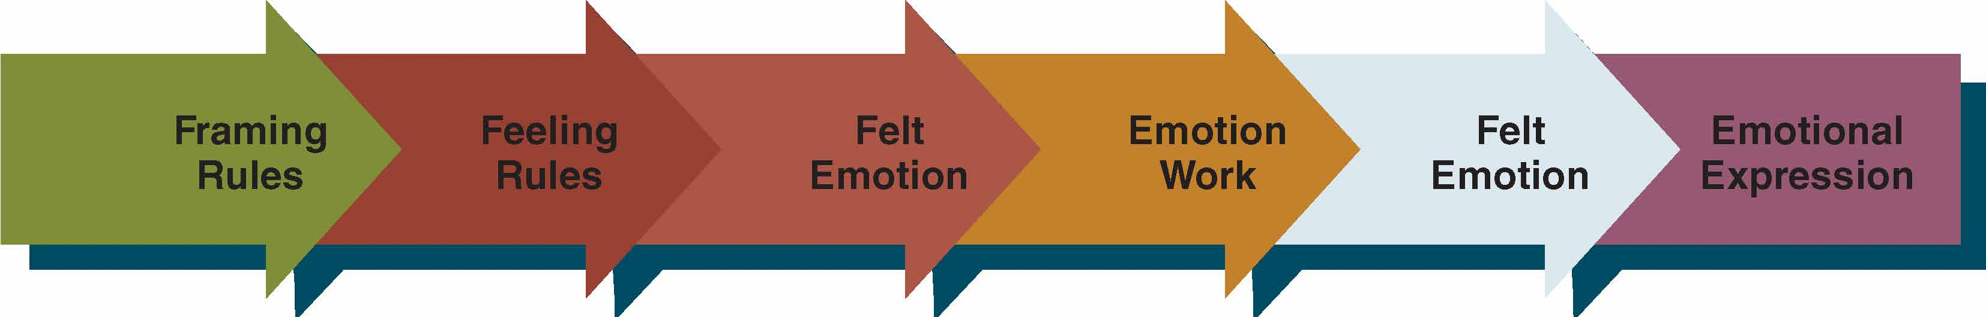
The Interactive View of Emotions framing rules, feeling rules, emotion work
Social Influences on Emotions

Slide 12
Obstacles to the Effective Communication of Emotions
Social and Professional Roles
Vulnerability
Protecting Others
Social Expectations

Slide 13
Ineffective Expression of Emotions
Speaking in Generalities
“I feel bad” or “I am happy”
Not Owning Feelings
Using YOU versus I language
Counterfeit Emotional Language
Expression of emotional content with no verbal clarification or content

Slide 14
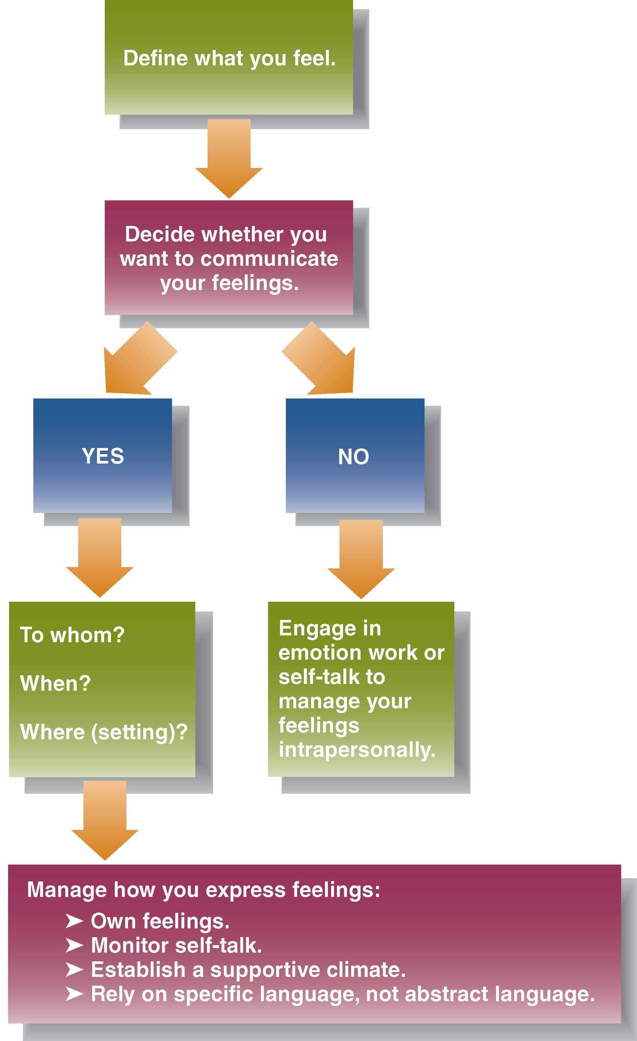
Guidelines for Communicating Emotions Effectively

Slide 15

Emotional Expressions
Everyone feels emotions. Emotional expression greatly varies from individual to individual.

Slide 16

Guidelines for Communicating Emotions Effectively (cont’d)
Identify Your Emotions
Choose How to Express Emotions
Own Your Feelings
Monitor Your Self-talk
Adopt a Rational–Emotive Approach to Feelings
Respond Sensitively When Others Communicate Emotions

Slide 17
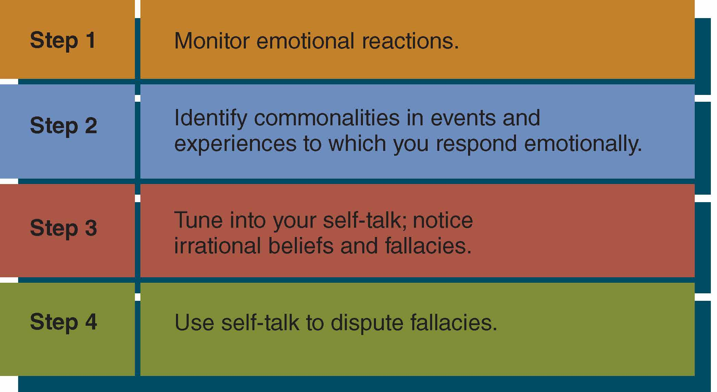
The Rational-Emotive Approach to Feelings

Slide 18
Common Fallacies About Emotions
Perfectionism
Obsession with “shoulds”
Overgeneralization
Taking responsibility for others
Helplessness
Fear of catastrophic failure

Slide 19
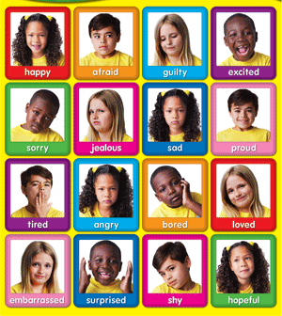
What is the Emotion?

Slide 20
What is the Emotion?

Slide 21
Summary
Emotion Definition
Identification of Emotion
Perception & Emotion
Chapter 4
Common Fallacies
Interpretation of Emotion
Rational-Emotive Approach
Emotional Expression

